Slide 1


20th Annual Family CAFÉ Conference 2018
Rick Scott
Governor
Barbara Palmer
Director
Notes:
Good Afternoon Everyone. I’m Rhonda Sloan, the CDC+ Administrator, the Agency for Persons with Disabilities. I am also a Representative for my daughter who has been on the CDC+ Program since 2001, I live the program each day and hope that you will find this presentation very informational and help you determine if the CDC+ program is right for you. How many people in the audience are already on the program? Or on the waiting list? Let’s begin

Slide 2
Overview of Presentation
CDC+Tools
Updates
Notes:
This presentation will provide information about the CDC+ Program tools, and Updates.
One of the best tool CDC+ offers is our website, I will walk through it and show you where to find the information that is available.
We will talk about how to be creative in CDC+
We will show you some of what is too come.

Slide 3
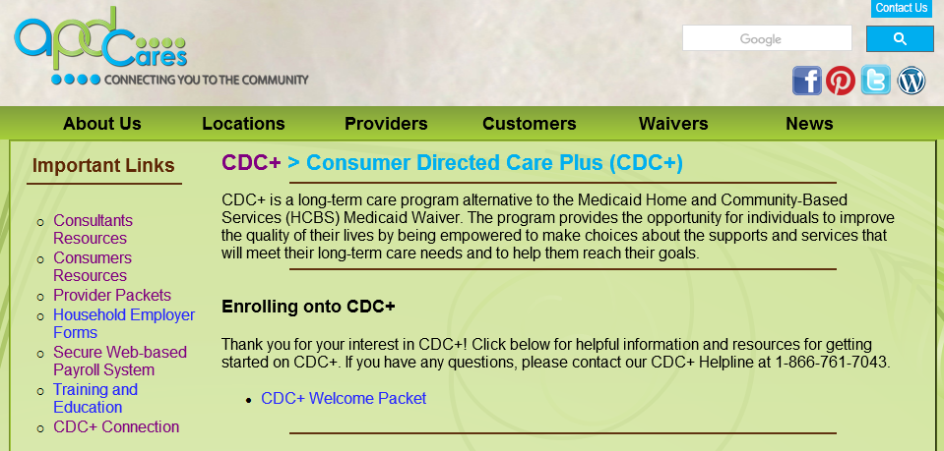
CDC+ Website
http://apd.myflorida.com/cdcplus/
3
Notes:
Let’s go around the room, how many of you are currently on CDC+.
Florida was one of the first 3 states to have a self directed program. The other 2 were Ark and NJ.
In CDC+ the consumer has “Budget authority” and “employer authority”.
CDC+ is based on person centered planning which can be described as a plan of life.

Slide 4
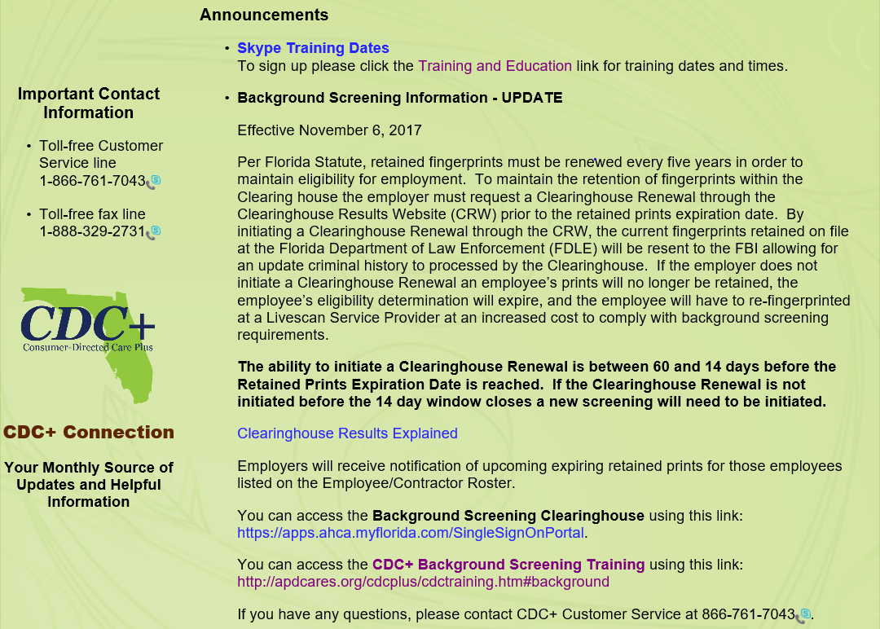

Slide 5
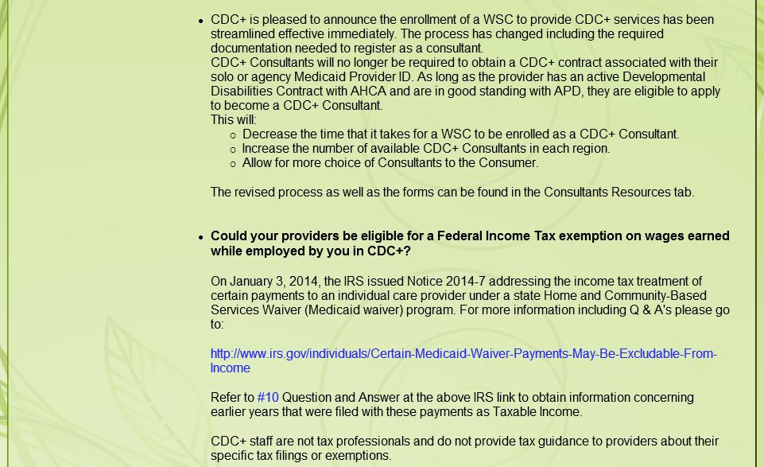
Notes:
As you continue to scroll down, you will see more announcements

Slide 6
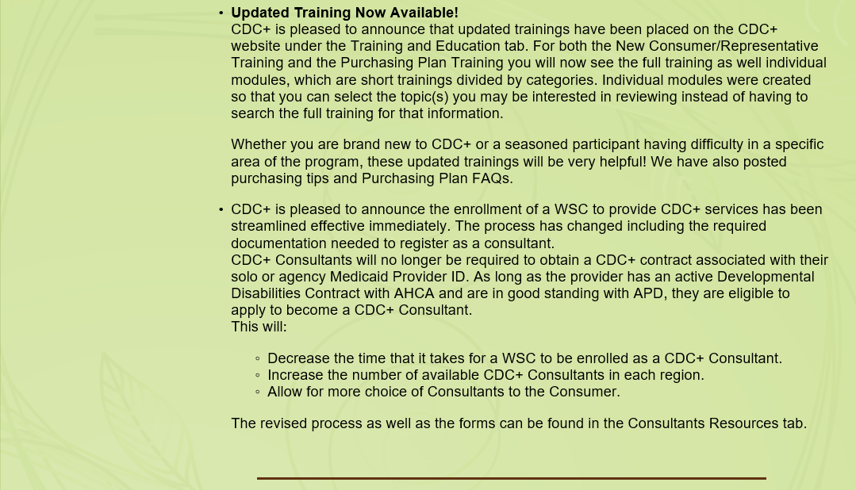

Slide 7
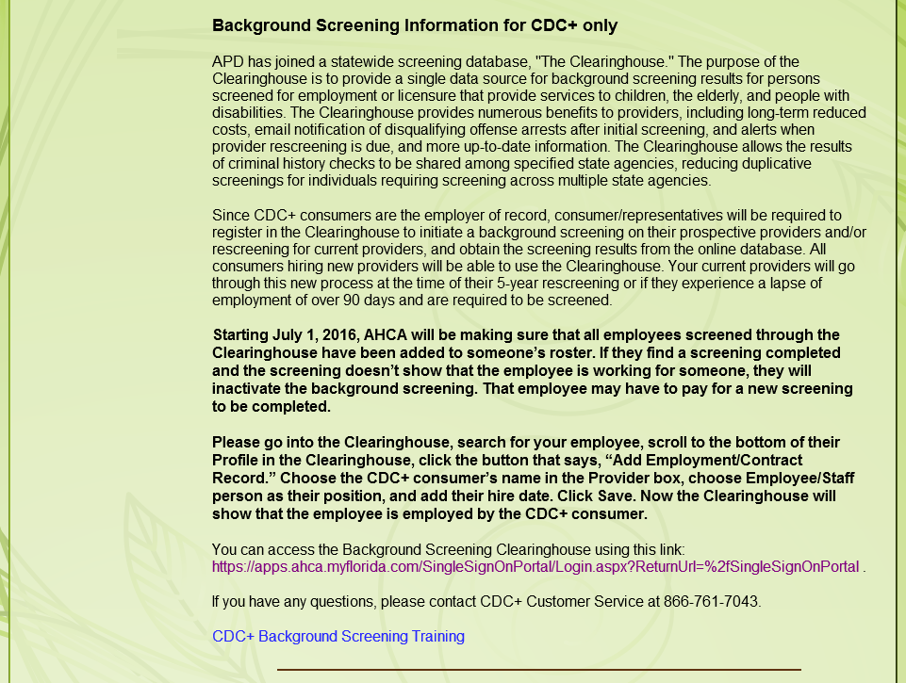
Notes:
I know there have been issues with the Background Screening clearing house. We send up all issues that are reported to CDC+.
Be sure to go out on the clearinghouse once a month to keep your account active.

Slide 8
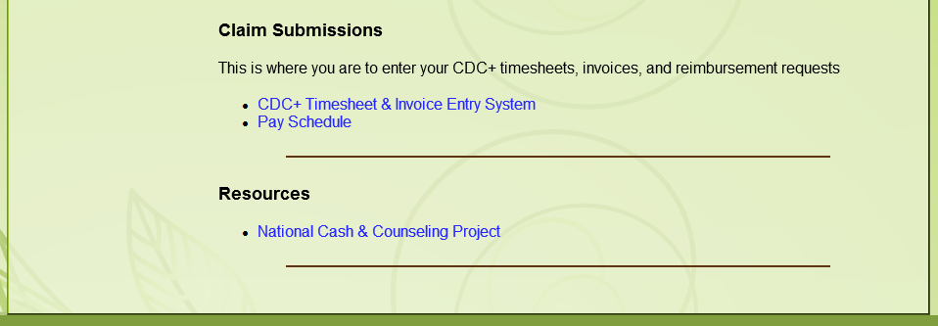
Notes:
At the bottom of the CDC+ website you will find:
a link to the Timesheet and Invoice Entry System
Current Pay schedule

Slide 9
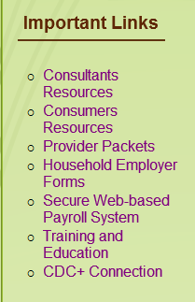
IMPORTANT LINKS

Slide 10
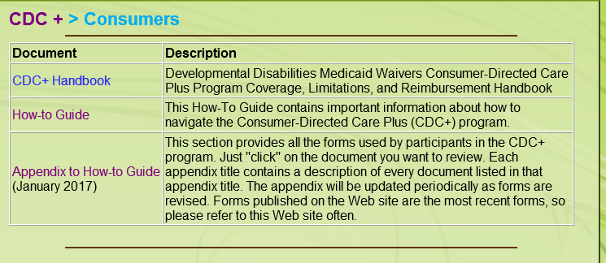
Consumers Resources Link
Notes:
The Consumer quick link is probably the most used by consumers and their representatives.
The CDC+ Handbook is the rule handbook for CDC+.
It provides definitions, a list of services that can be purchased in CDC+.
description of everything service -
Limitations and special conditions – age requirement of consumer is an example of this
Provider qualifications – age requirements, training requirements, licenses that may be required
Service type – restricted or unrestricted
The How-to Guide is quick reference tool on how to do certain things in CDC+.
The Appendix to How-To Guide is the forms that are used in CDC+

Slide 11
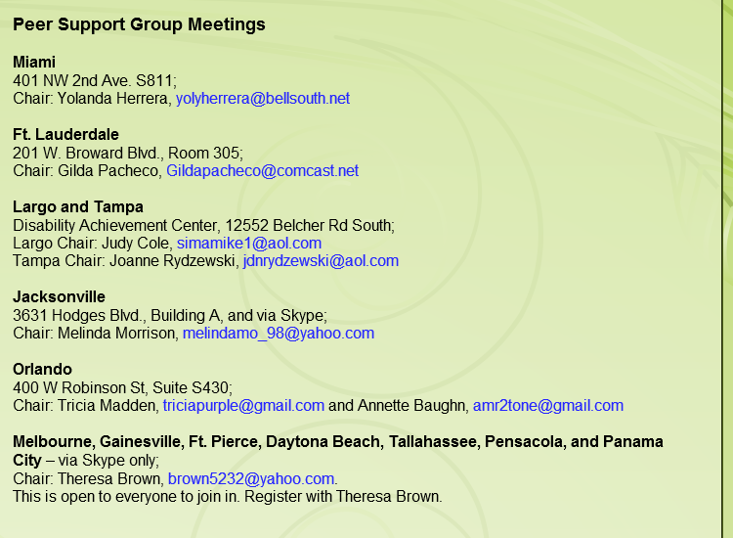
Consumers Resources (cont’d)
Notes:
On the consumers quick link, we provide the contact information for the chairs of the peer support groups. If the peer support group chairs provide CDC+ with the dates and times their meetings are held, they will be listed in the CDC+ Connection newsletter each month.

Slide 12
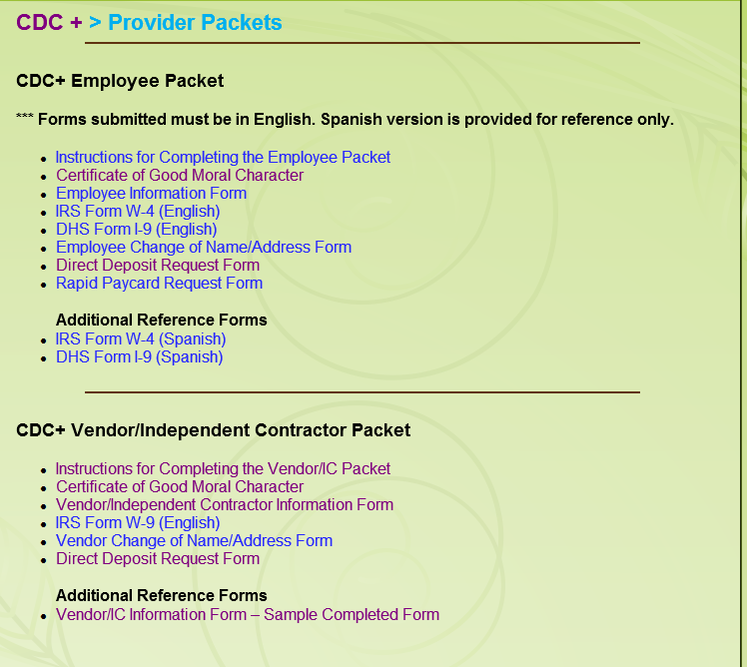
Provider Packets Link
Notes:
The Packets you would use for your Directly Hired Employees, your independent contractors and Agency Vendors can be found using this quick link.
There are also samples available also

Slide 13
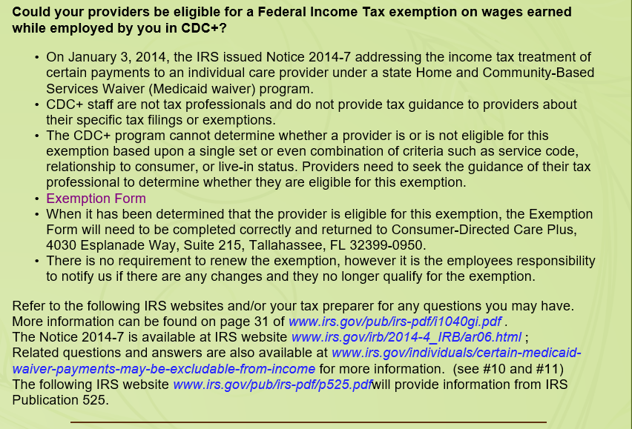

Slide 14
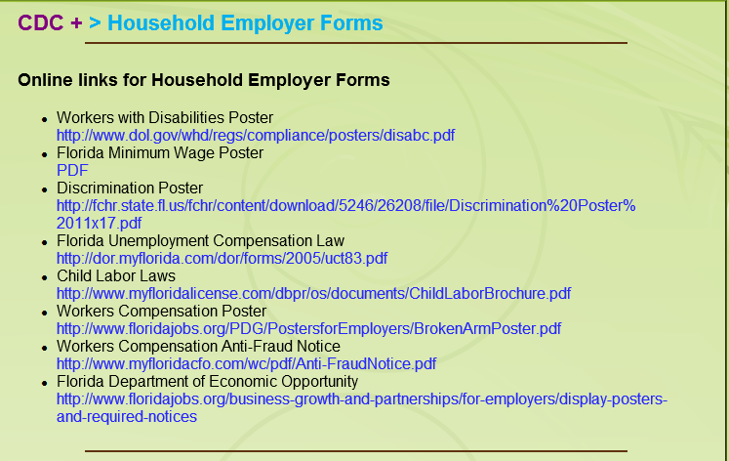
Household Employer Forms Link
Notes:
When an individual enrolls into CDC+, they become a domestic household employer.
This quick link will provide all the employer forms that you will need. Pay close attention to Floridas Child Labor Laws.
These signs are available in Spanish also on the website
The State of Florida and APDCares.org (APD) do not control or guarantee the accuracy, relevance, timeliness or completeness of information contained on a linked website.
APD does not endorse the organizations sponsoring linked websites and does not endorse the views they express or the products/services they offer.
APD cannot authorize the use of copyrighted materials contained in linked websites. Users must request such authorization from the sponsor of the linked website.
APD is not responsible for transmissions users receive from linked websites

Slide 15
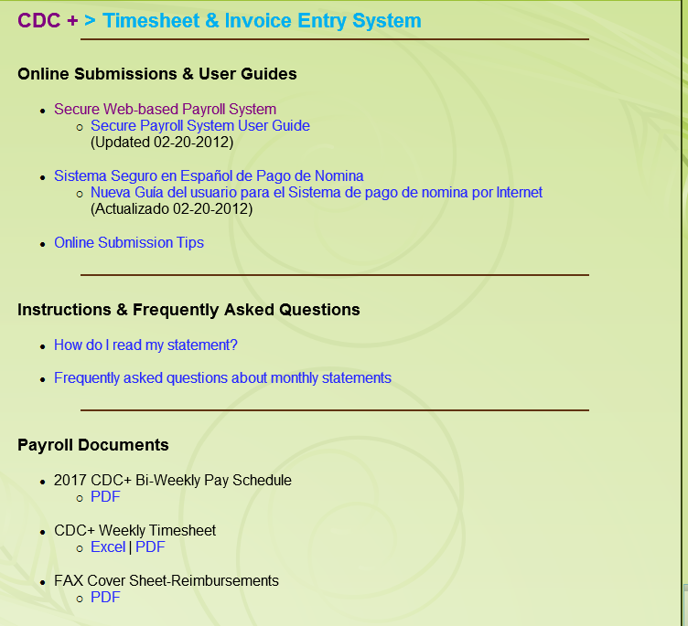
Secure Web-Based Payroll System Link

Slide 16
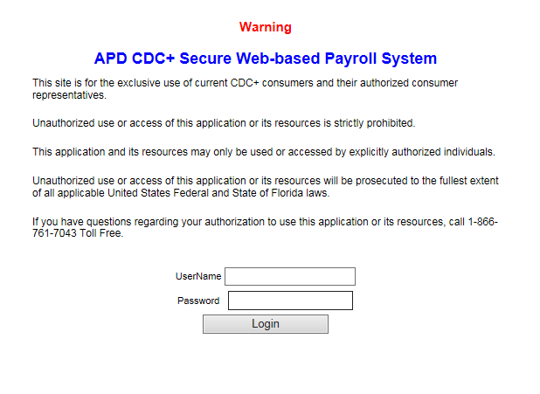
Secure Web-Based Payroll System

Slide 17
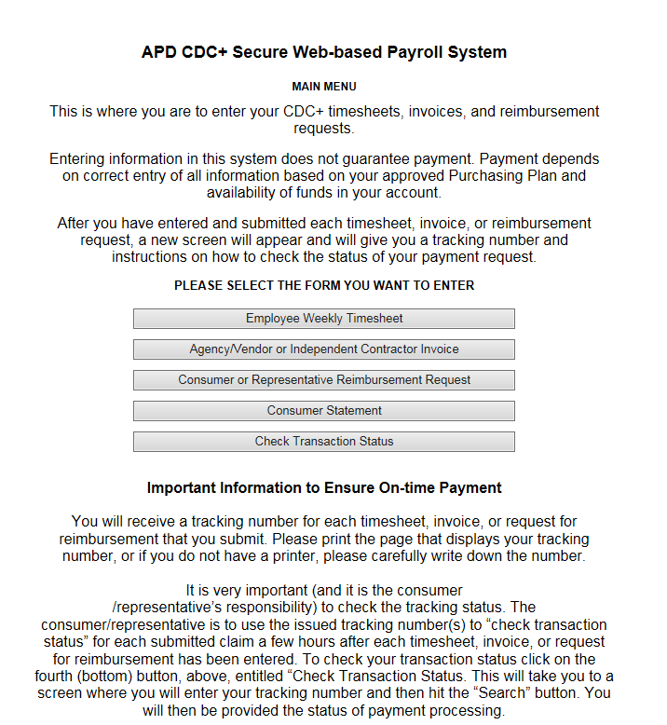
Secure Web-Based Payroll System (cont’d)
Notes:
There is also a link to a Spanish version

Slide 18
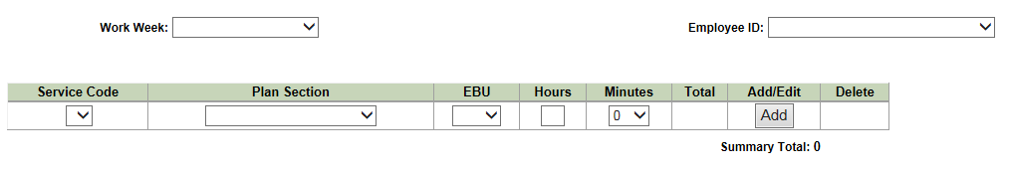
Secure Web-Based Payroll System (cont’d)

Slide 19
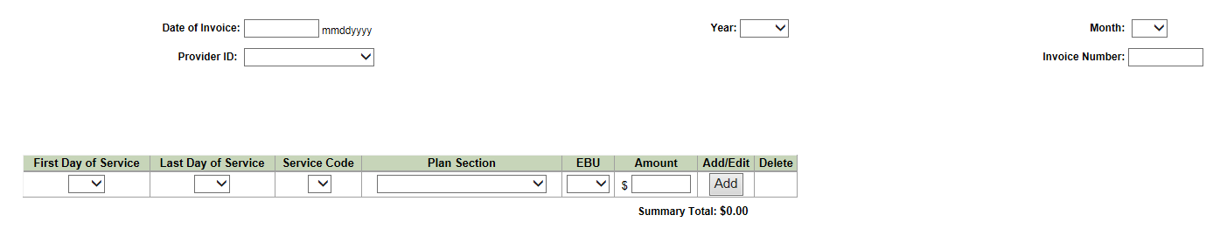
Secure Web-Based Payroll System (cont’d)

Slide 20
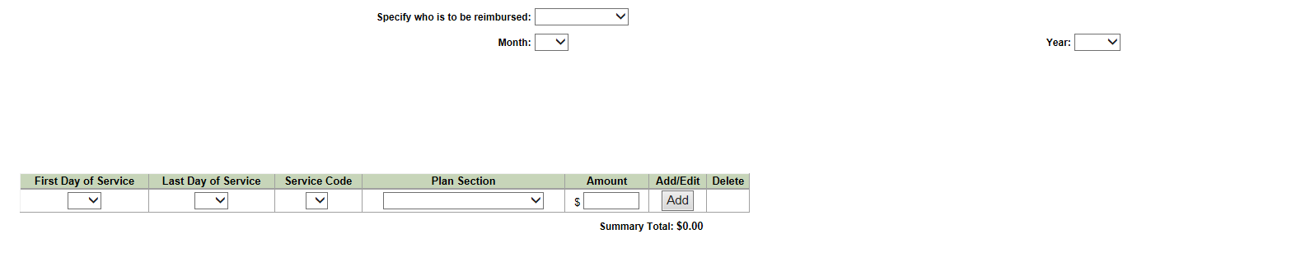
Secure Web-Based Payroll System (cont’d)

Slide 21
Secure Web-Based Payroll
System (cont’d)
Notes:
The consumer statement is mailed to the consumer’s address on file unless we have been given another address, the representative and get a copy of the monthly statement here.
It is very important (and it is the consumer
/representative’s responsibility) to check the tracking status. The consumer/representative is to use the issued tracking number(s) to “check transaction status” for each submitted claim a few hours after each timesheet, invoice, or request for reimbursement has been entered. To check your transaction status click on the fourth (bottom) button, above, entitled “Check Transaction Status. This will take you to a screen where you will enter your tracking number and then hit the “Search” button. You will then be provided the status of payment processing.
If you receive the message, “Processing, please check back for an updated status,” please wait three to four hours and check back. If you enter payment information after 5 p.m. Eastern Time, processing may not be complete until the next morning.
The APD payment system functions very effectively but in order to help us provide on-time payments you must check the transaction status on all Web submissions, and alert CDC+ staff immediately when you receive any message other than “Processing” or “Approved”.

Slide 22
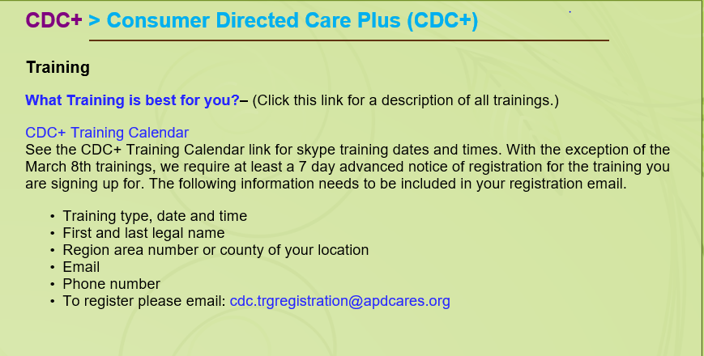
Training and Education Link

Slide 23
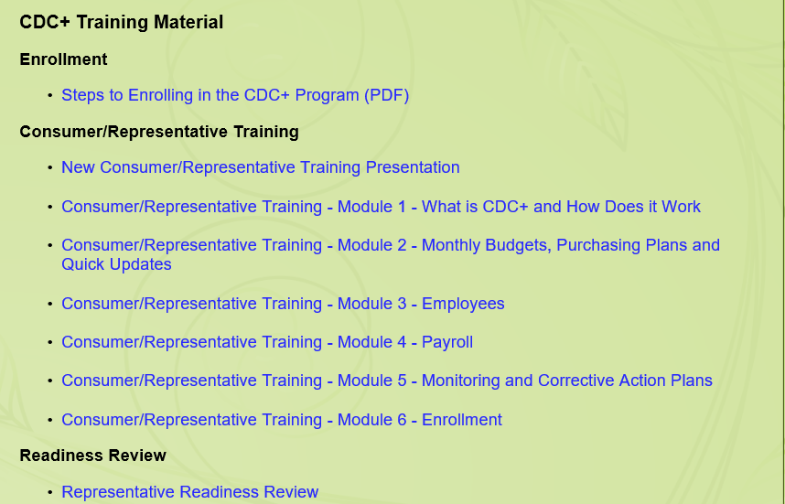
Training and Education (cont’d)

Slide 24

Training and Education (cont’d)

Slide 25
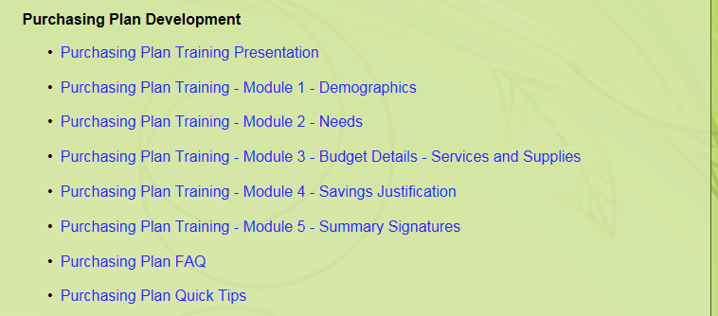
Training and Education (cont’d)

Slide 26

Training and Education (cont’d)

Slide 27

Training and Education (cont’d)

Slide 28

CDC+ Connection Link

Slide 29
COMING SOON
Enhancements to:
APD CDC+ Secure Web-based Payroll System
  Training will be provided
  Guide will be developed

Slide 30
Enhanced
APD CDC+ Secure Web-based Payroll System
TIMESHEET ENTRY

Slide 31
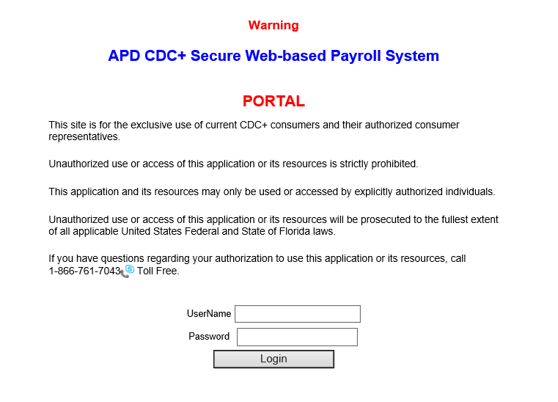
Notes:
Hours reported to you on your employee timesheets would be entered the Secure Web-Based Payroll System only after the timesheets have been verified and signed as being correct by the Consumer or Representative (if applicable).

Slide 32
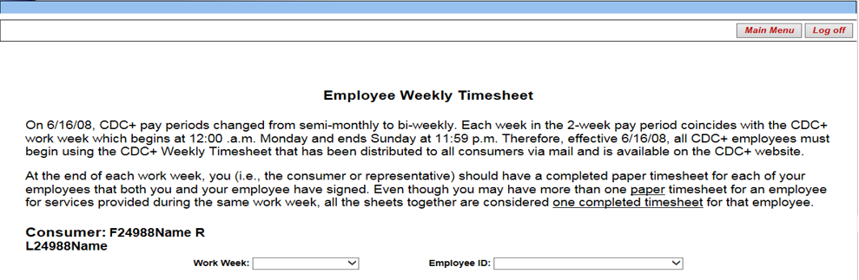
SELECT A WORKWEEK and PROVIDER
Notes:
When submitting hours for your employees, you must have the timesheet
When entering hours always go left to right on the screen

Slide 33
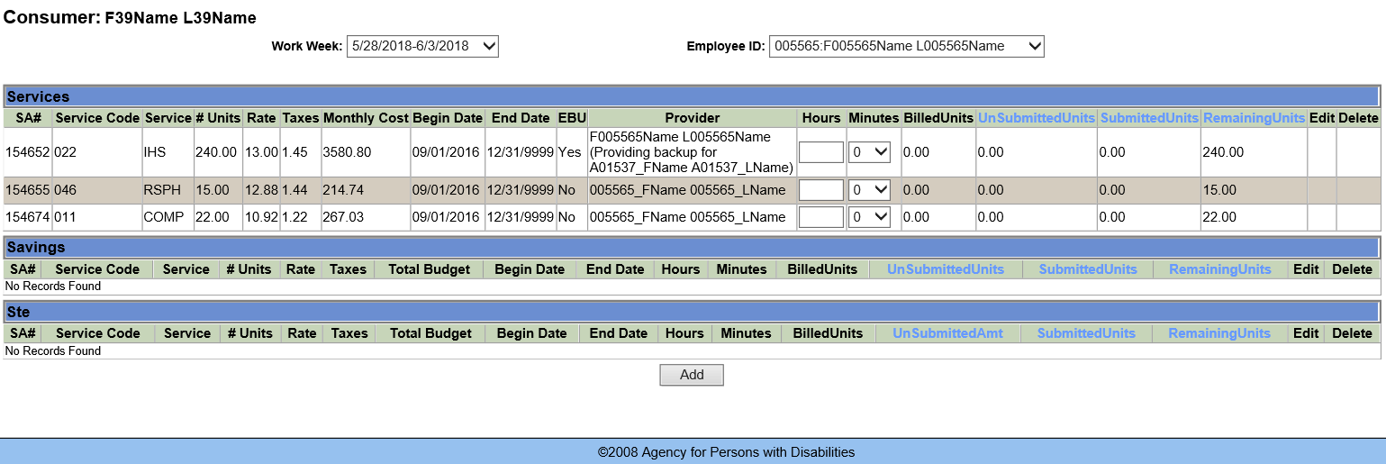
Notes:
All Services authorized to be provided as a primary or EBU by the selected provider in the Services, Savings and the STE sections of the current approved Purchasing Plan will be shown on screen.
Please note on the left side of the screen, the following information: (This information is in the current approved Purchasing Plan)
Service Code
Service Abbreviation
Total # Units
Rate
Taxes (if applicable)
Monthly Cost
Begin Date/End Date
EDU YES or NO

Slide 34
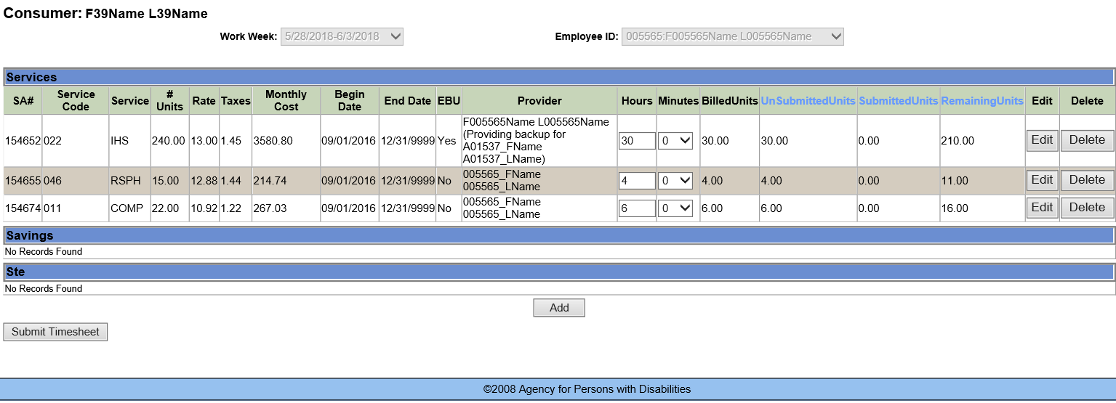
ENTER HOURS FOR EACH SERVICE CODE
Notes:
After adding the hours you entered, you will see the hours you entered are showing as billed units and as unsubmitted units. (Because you have not yet submitted the timesheet)
You will also see that the billed units have been subtracted from the total # of units authorized on the current approved Purchasing Plan
To submit the hours entered push SUBMIT TIMESHEET

Slide 35
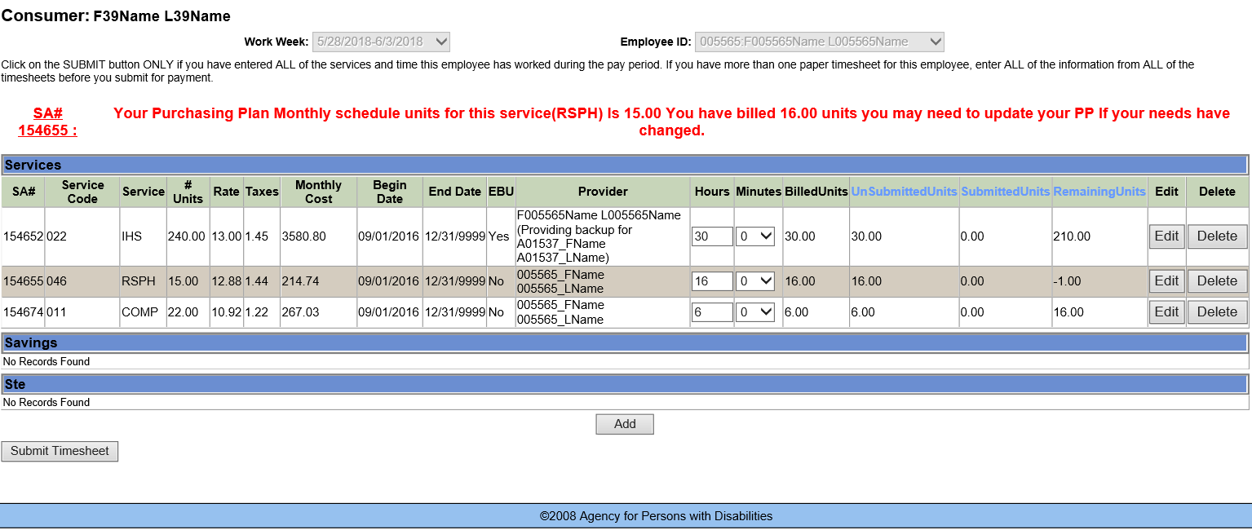
Notes:
If more hours than are authorized are entered for payment, you will receive the following error message
Your Purchasing Plan Monthly schedule units for this service (RSPH) is 15.00. You have billed 16.00 units you may need to update your PP if your needs have changed.
If you meant to enter more than the number of units authorized in the current approved Purchasing Plan, you can still submit the timesheet. If the this will be consistent change in the number of hours being provided, the Purchasing Plan must be updated. Spending in excess of the authorized hours consistently is considered being out of compliance with the CDC+ program rules.

Slide 36
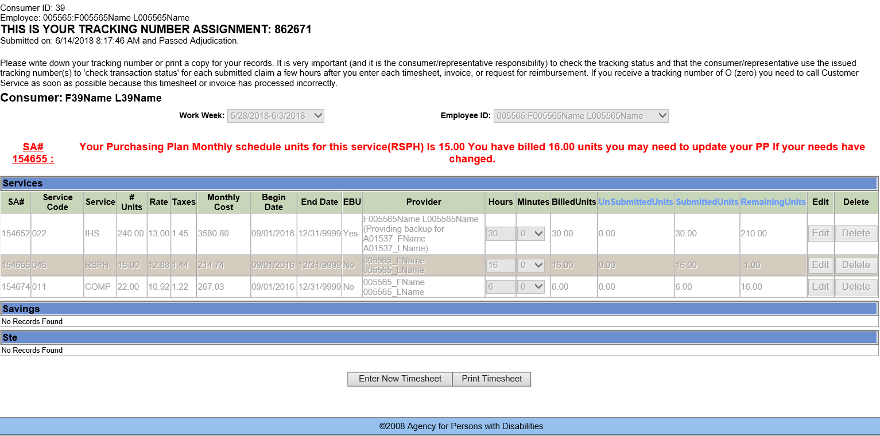

Slide 37
INVOICE ENTRY

Slide 38
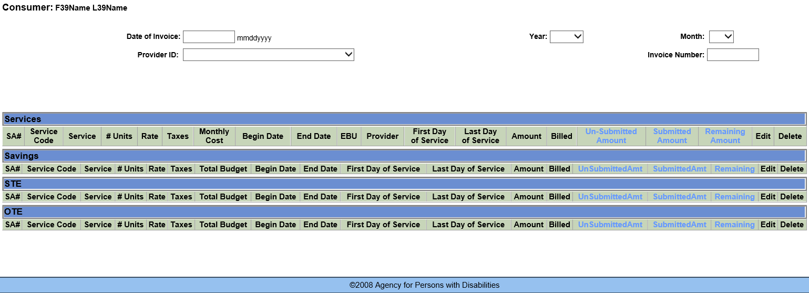
SELECT DATE and PROVIDER

Slide 39
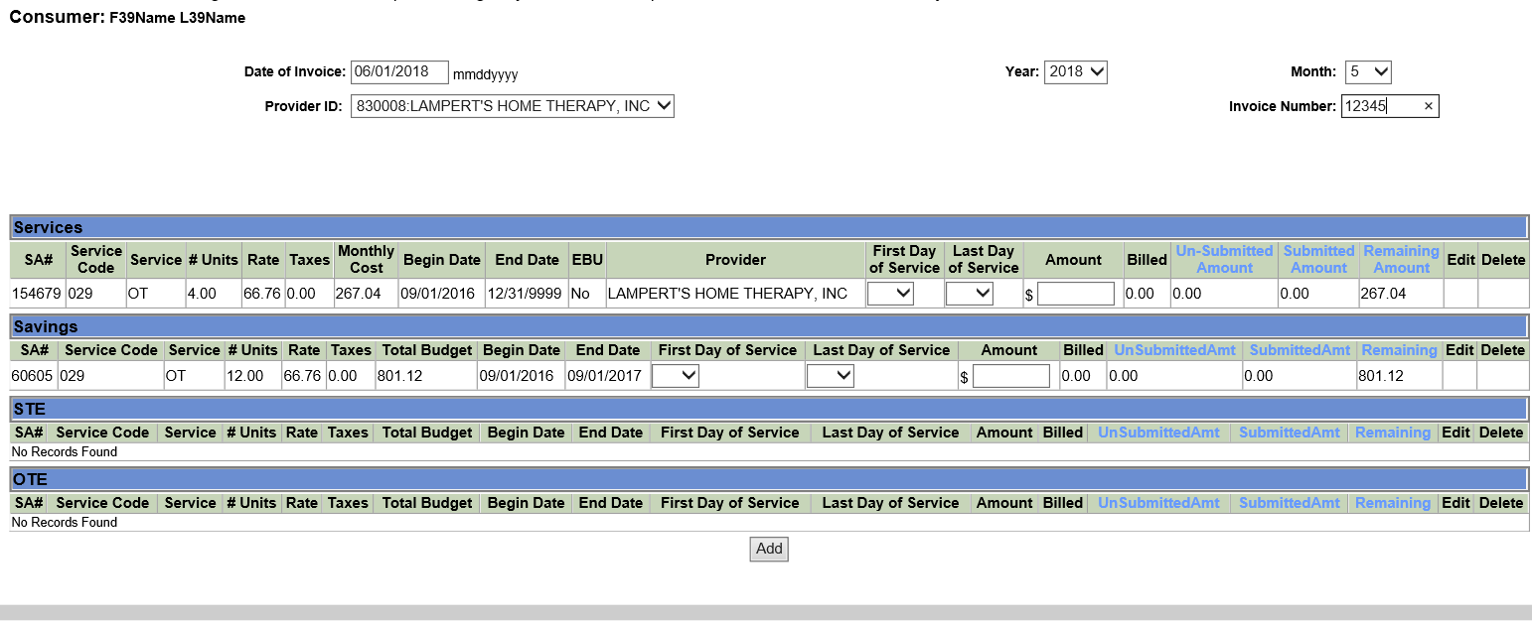

Slide 40
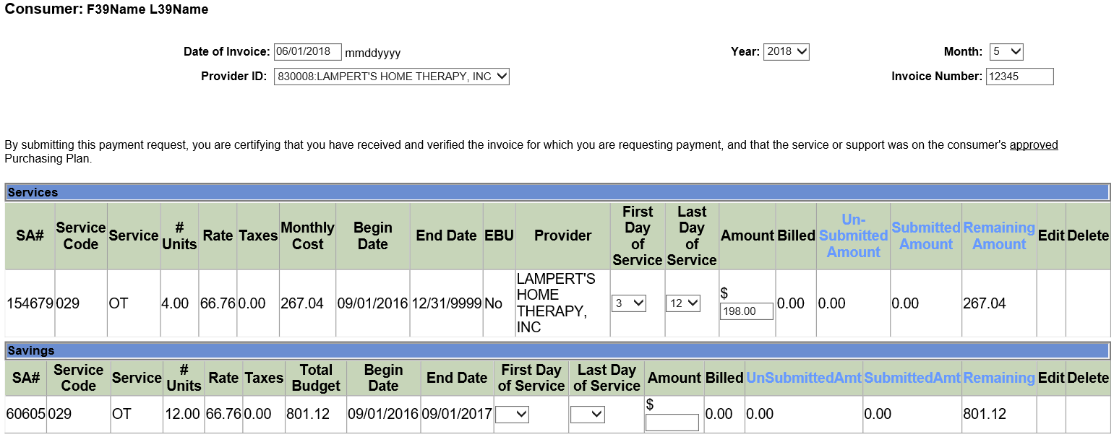
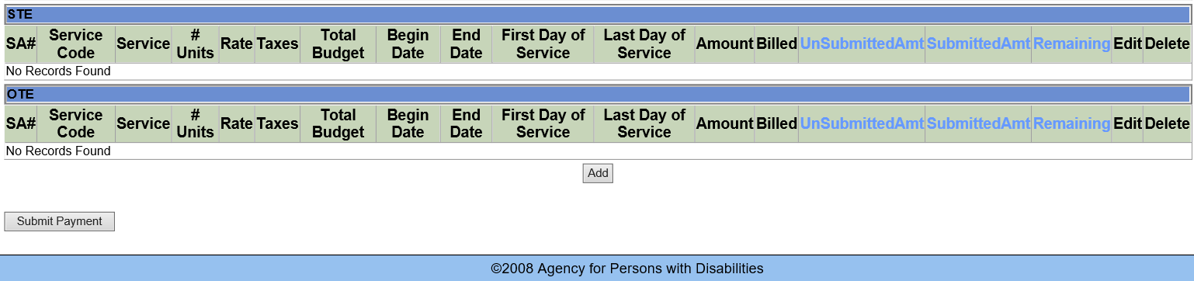
ENTER SERVICE DATES and
AMOUNT BEING SUBMITTED FOR PAYMENT

Slide 41
REIMBURSEMENT REQUEST ENTRY

Slide 42
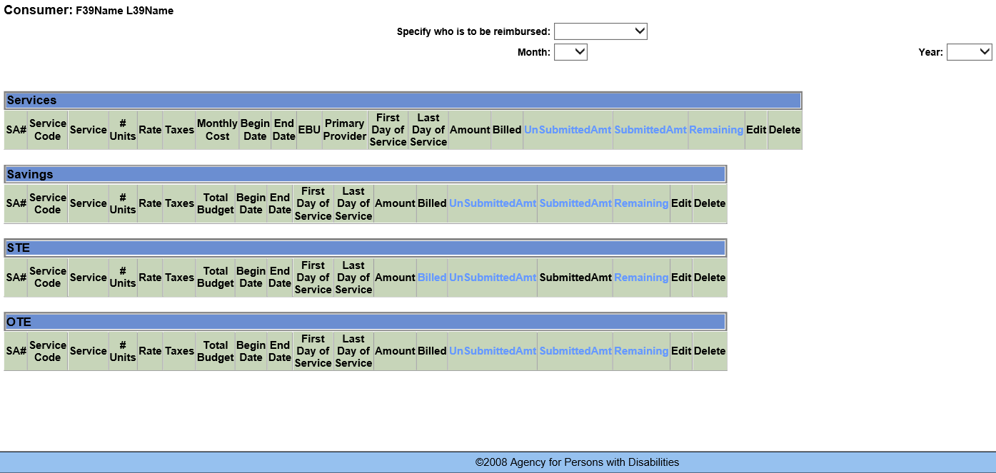
SELECT WHO, MONTH and YEAR

Slide 43
UPDATES
Paid receipts and invoices are required for Reimbursement submissions more than $100.00.
Administrative Correction Notices are sent out for items that are incorrect or missing on:
  Purchasing Plans
  Quick Updates
  Provider Packets
  Reimbursement Requests
10 days to submit corrections or missing items
Notice of Denial sent for items that cannot be approved or information requested is not submitted.
Notes:
Updates of things that has or is occurring and also upcoming things
important information about program requirements for keeping and submitting Timesheets, Invoices and Reimbursements. Please read it and keep it for future reference. The information attached explains:
How and Why your Directly Hired Employees (“DHE”) must complete a weekly paper timesheet
Why the timesheet needs to be signed by both the DHE and you
How and When to submit DHEs time worked so that they will be paid
What to do with the invoices you receive from Independent Contractors (“IC”) and Agency Vendors (“A/V”)
How and When to submit the invoices so that your IC and A/V will receive payment
What documents you must keep for goods or services you have on you Purchasing Plan for Consumer/Representative Reimbursement
How to submit a request for Consumer/Representative Reimbursement
Record retention requirements
Reconciliation and Purchasing Plan Training
Consultant Registration Streamlined
Quick-ups are sent direct to CDC+State office
Enhancements to FEA System
Providing Reconciliation and Purchasing Plan trainings
Consultant Registration Streamlined
Quick-ups are sent direct to CDC+ State office
Enhancements to FEA System
Paid receipts and invoices are required for Reimbursement submissions
Notices will be sent out for items not approved on the Savings page – Due process rights

Slide 44
Quick Tips & Reminders
CDC+ timesheets must be used.
Don’t wait until the last minute to submit payroll.
Employees must be added to the Employee Roster in the
BGS Clearinghouse when hired and removed when they no longer work for you.
Timesheets and Invoices are submitted for payroll after Services have been rendered.
Accounts must be reconciled when Monthly Statements are received.
Items listed in the Savings Section are items that are special purchases that are needed by the consumer now. The estimated date of purchase is determined by the number of months it would take to accumulate the necessary amount of funds to make the purchase. If there is sufficient funds unspent in the account, the purchase should be made.
Don’t forget to submit the request for reimbursement by calling into Customer Service or through the Secure Web-based Payroll System prior to faxing or emailing the required documentation.

Slide 45


Q & A Session
45
Notes:
You can also list your questions on the index cards and I will get back to you.

Slide 46

Thank You
Customer Service is available
Monday through Friday (8:00 A.M. – 5:00 P.M. EST), excluding state holidays.
CDC+ Customer Service 1-866-761-7043
Rhonda Sloan, CDC+ Administrator
Rhonda Sloan@apdcares.org 850-414-5070
Meghan Kirkley, Program Administrator
Meghan.Kirkley@apdcares.org 850-413-6694
Lydia Bustillo, Training/Outreach Coordinator
Lydia.Bustillo@apdcares.org 850-274-1211
46

